Slide 1
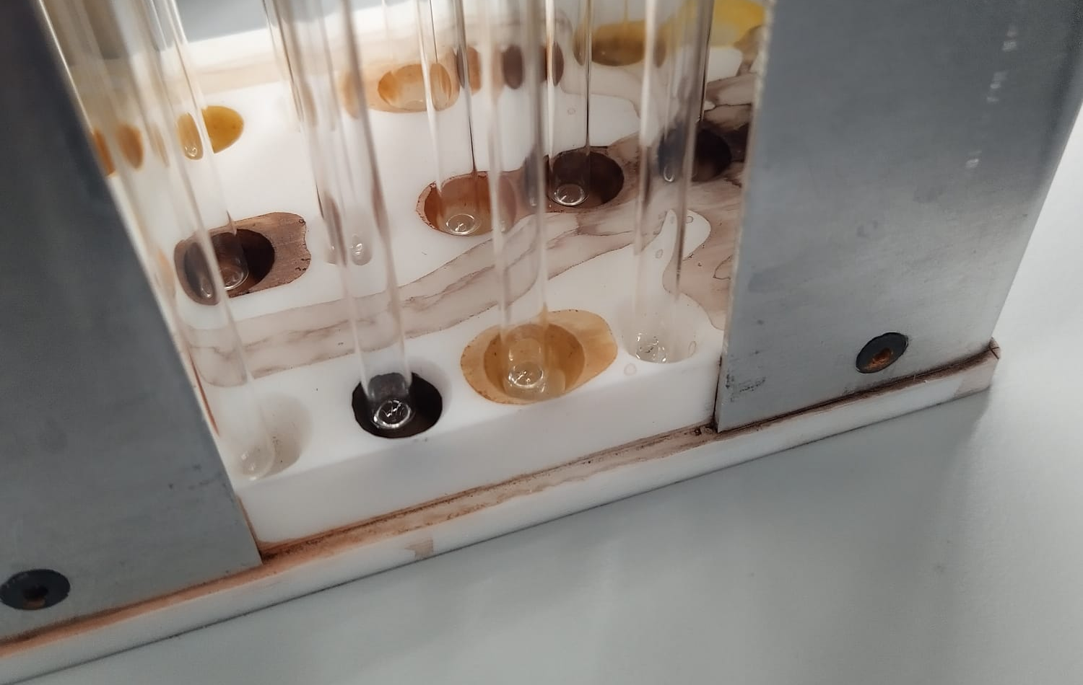
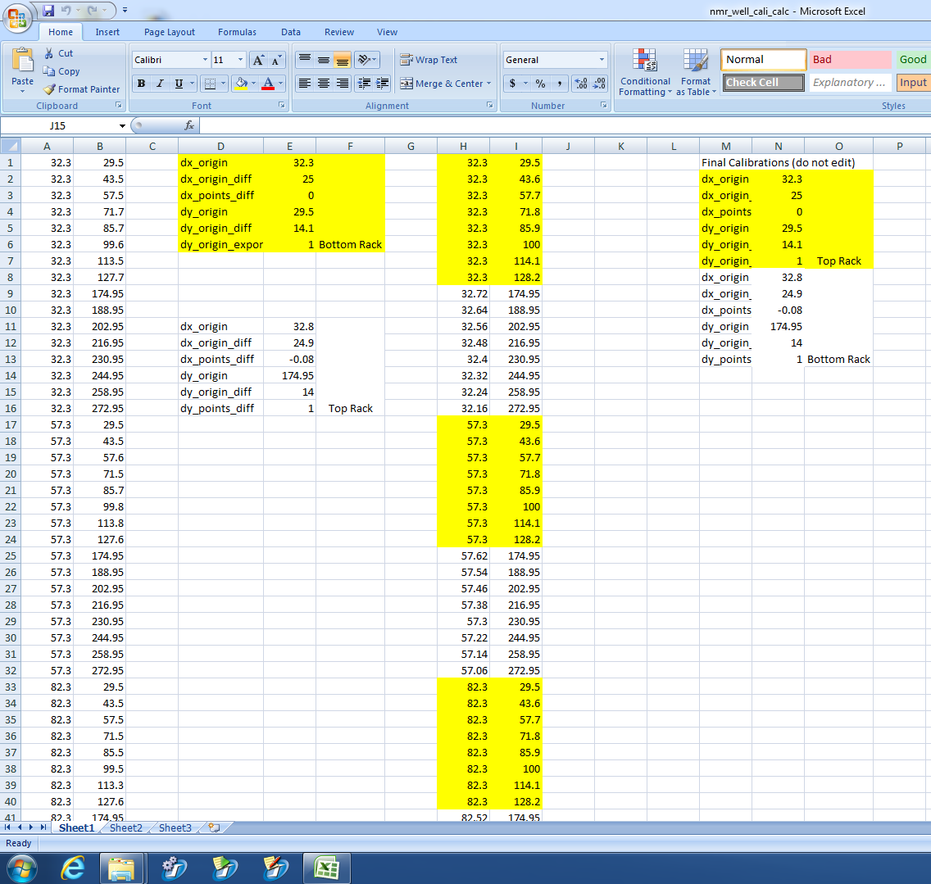
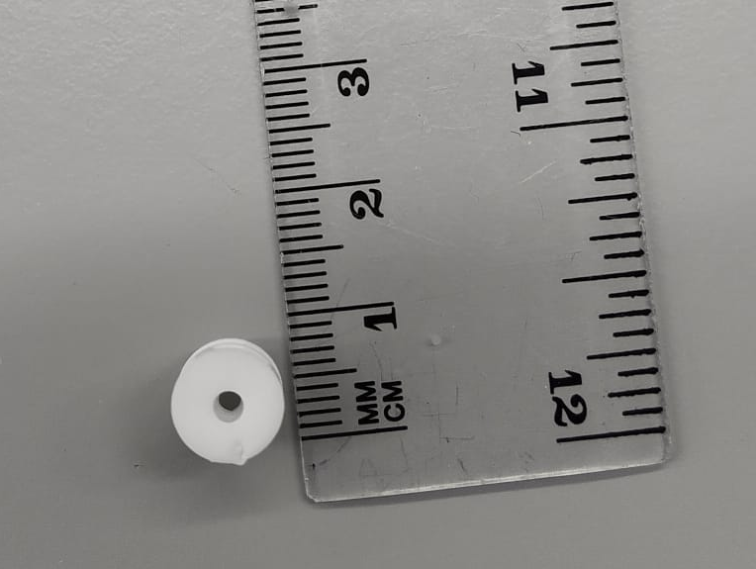
A
Parameters governing the new NMR tube locations
Swing
Needle
B
NMR
lid
Minimum needle depth to prevent sample overflow
D
NMR
tube
C

